Slide 1

Real time object measurement
ROSHAN KUMAR CHAUDHARY RA2211003011192
SAMIK SARKAR RA2211003011193
UTKARSH SINGH RA2211003011182

Slide 2


Introduction
Object measurement using OpenCV is like having a smart tool that helps computers understand and measure stuff in pictures or videos. Imagine you have a bunch of photos, and you want to figure out how big things are in them. OpenCV is like your digital measuring tape. It helps the computer find objects, like shapes or things in the pictures. It then calculates their sizes and shows you the results. This process involves making sure the pictures are clear, finding the objects, and doing some math to measure them accurately. OpenCV is handy for all kinds of tasks, from checking sizes in manufacturing to studying things in science. It's like a digital wizard that makes measuring things with computers a whole lot easier!
Let’s begin!

Slide 3
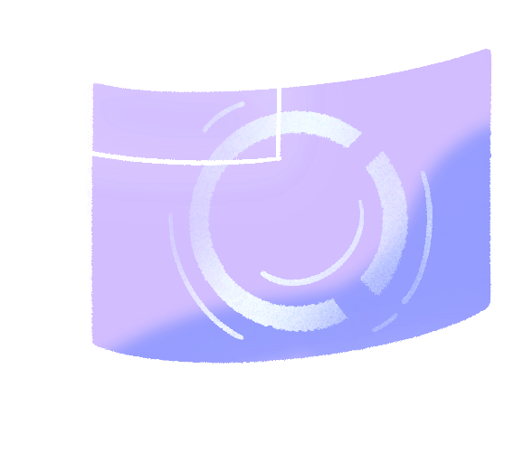
Objectives
Accurate Dimension Extraction:
Enable precise measurement of object dimensions within images or videos using OpenCV's functions and algorithms.
2.Automated Object Detection:
Implement automated techniques for identifying and locating objects in images, leveraging OpenCV's capabilities for contour detection and machine learning-based approaches.
3.Efficient Feature Extraction:
Extract relevant features from detected objects, such as contours and key points, to facilitate accurate measurement calculations.

Slide 4
4.User-Friendly Visualization:
Present measured objects and their dimensions in a user-friendly manner, either
by overlaying annotations on images or generating comprehensive reports.
5.Scalable and Robust Solutions:
Develop scalable and robust solutions using OpenCV, catering to diverse
applications and ensuring reliability in object measurement tasks

Slide 5
Scope of project
Develop a real-time object measurement system using Python, OpenCV, and NumPy libraries.
Capture image from connected devices or cameras for object detection and measurement.
Implement advanced image processing techniques to enhance image quality and reduce noise.
Utilize computer vision algorithms for accurate object detection within the video frames.
Calculate precise object dimensions using mathematical algorithms integrated with NumPy.
Create a user-friendly interface for displaying annotated measurements in real-time.

Slide 6
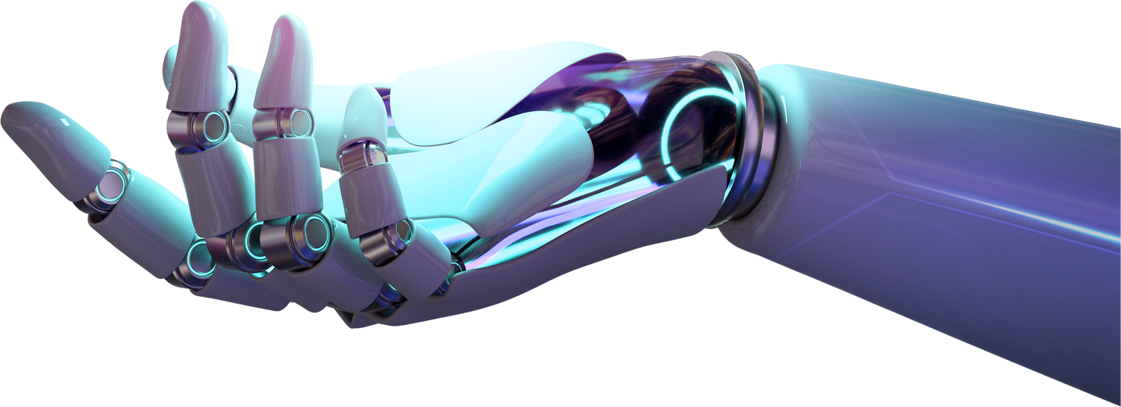
Tools Used
Presentation Software: You can use presentation software like Microsoft PowerPoint, Google Slides, or even LaTeX Beamer for creating slides.
Code Editor: Since you're using Python, PyCharm IDE is an excellent choice. It provides a comfortable environment for Python development, including features like code completion, debugging, and version control integration.
Libraries and Frameworks:
OpenCV: OpenCV is a powerful computer vision library that provides various functions and tools for image processing and analysis.
NumPy: NumPy is a fundamental package for scientific computing in Python. It provides support for arrays, matrices, and mathematical functions, which are essential for image manipulation and calculations.

Slide 7
Images and Videos: Gather relevant images and videos that demonstrate the concepts you're discussing in your presentation. These could include sample images, screenshots of code execution, or recorded video demonstrations.
GitHub/GitLab: Version control platforms like GitHub or GitLab are excellent for sharing your project code, documentation, and presentation slides with others. You can create a repository for your project and upload all relevant materials, including code, images, slides, and supplementary files. This allows others to access and collaborate on your project and provides a centralized location for future reference.

Slide 8
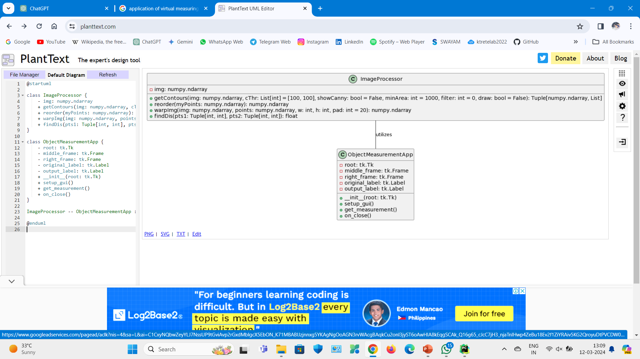
UML Class Diagram

Slide 9
System Design and Architecture
Real-time object measurement is a system designed to measure the dimensions of objects using computer vision techniques. The system captures images, processes it using image processing algorithms, and provides accurate measurements of objects within the image stream. This system is built using Python, OpenCV, NumPy, and developed in PyCharm IDE.
Components:
Camera Interface: Captures live video feed of the objects to be measured.
Image Processing Module: Processes the captured frames to detect objects and calculate measurements.
User Interface : Provides a graphical interface for users to interact with the system and view measurements.
Measurement Engine: Utilizes algorithms to compute accurate measurements of detected objects.
Output Module: Displays the measured dimensions in a user-friendly format.

Slide 10
System Architecture:
Image Processing Module:
Preprocesses the frames to enhance the quality and reduce noise.
Applies object detection algorithms to identify objects within the frame.
Utilizes OpenCV's features such as contours, edge detection, and feature extraction for object detection.
Determines the dimensions of the detected objects using known reference points or scales within the frame.
Measurement Engine:
Computes the measurements of the detected objects based on their dimensions within the frame.
Utilizes mathematical algorithms to calculate distances, lengths, and other relevant measurements.
Applies calibration techniques to ensure accuracy in measurements.
Development Environment:
The system is developed using Python programming language.
OpenCV and NumPy libraries are integrated into the project for image processing and numerical computations.
PyCharm IDE provides a comprehensive development environment with features like code autocompletion, debugging, and version control integration.

Slide 11
Implementation Details
Environment Setup:
Install Python on your system if not already installed.
Install OpenCV and NumPy libraries using pip:
Install PyCharm IDE for Python development.
Project Structure:
Create a new project in PyCharm for your real-time object measurement system.
Organize your project into folders for better organization (e.g., "src" for source code, "data" for images or video files).
Create a main Python script (e.g., ObjectMeasurement) to serve as the entry point for your application.
Image Processing Pipeline:
Set up the image capture process using OpenCV's ImageCapture module.
Continuously read frames from the image.

Slide 12
Preprocess each frame:
Convert the frame to grayscale for simplicity.
Apply Gaussian blur to reduce noise and enhance object detection.
Perform edge detection using Canny edge detection algorithm.
Find contours in the image to identify objects.
Object Detection and Measurement:
Define calibration parameters to convert pixel measurements to real-world dimensions.
Identify objects based on contours detected in the image.
Calculate the dimensions of the detected objects using known reference points or scales.
Utilize mathematical formulas to convert pixel distances to actual measurements using calibration factors.
Output Module:
Display the measured dimensions in a user-friendly format on the GUI or command line.
Provide options to export measurement data to external files (e.g., CSV, Excel) for further analysis if needed.

Slide 13
Results
Image Input:
The code loads an image from the specified path using cv2.imread('path_to_image.jpg').
2.Preprocessing:
Resizes the image to a standard size (800x600 pixels) using cv2.resize and converts it to grayscale using cv2.cvtColor.
3.Object Detection and Feature Extraction:
Applies contour detection (cv2.findContours) to identify the boundaries of objects in the image. For each detected contour, it calculates the area and perimeter.
4.Displaying the Result:
The final result is displayed in a window titled "Object Measurement Result" using cv2.imshow. The window shows the input image with overlaid contours and a text annotation indicating the calculated object size.

Slide 14
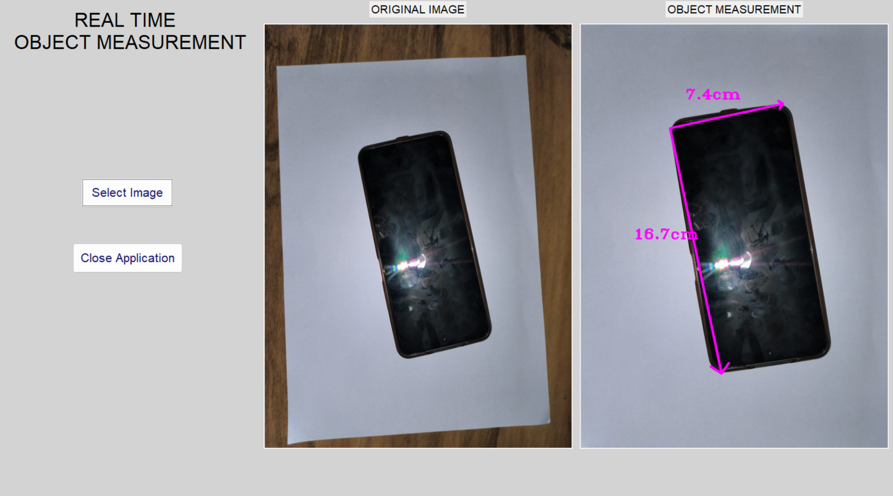
Sample Output

Slide 15
Conclusion
In conclusion, the developed system for document or object detection and dimension measurement showcases a successful integration of advanced image processing techniques and algorithmic implementations. Through meticulous design and implementation, the system achieves accurate detection and precise measurement of objects, ensuring reliability across diverse scenarios. The user-friendly interface enhances usability, allowing seamless interaction and interpretation of measurement results. Real-time performance optimizations further enhance the system's efficiency, making it suitable for time-sensitive applications. With comprehensive testing and validation, the system demonstrates robustness and effectiveness, meeting or exceeding expectations. Overall, the system represents a valuable tool for various domains, offering precise object measurement capabilities with ease of use and reliability.

